Slide 1
Introduction to Web Backend

Slide 2
Scalability
Scalability is an ability to adjust the capacity of the system to cost efficiently fulfill the demands.
Scalability usually means an ability to handle more users, clients, data, transactions, or requests without affecting the user experience.
It is important to remember that scalability should allow us to scale down as much as scale up and that scaling should be relatively cheap and quick to do.

Slide 3
Dimensions to Measure Scalability
Handling more data
Handling higher concurrency levels
Handling higher interaction rates
As you have probably noticed, scalability is related to performance, but it is not the same thing. Performance measures how long it takes to process a request or to perform a certain task, whereas scalability measures how much we can grow (or shrink).

Slide 4
Evolution from a Single Server to a Global Audience
Many of the scalability evolution stages presented here can only work if you plan for them from the beginning. In most cases, a real-world system would not evolve exactly in this way, as it would likely need to be rewritten a couple of times.
Most of the time, a system is designed and born in a particular evolution stage and remains in it for its lifetime, or manages to move up one or two steps on the ladder before reaching its architectural limits.

Slide 5
Virtual private server
Virtual private server is a term used by hosting providers to describe a virtual machine which can be rented. When you purchase a VPS instance, it is hosted together with other VPS instances on a shared host machine.
VPS behaves as a regular server—you have your own operating system and full privileges.
VPS is a good starting point, as it is cheap and can usually be upgraded instantly (you can add more random access memory [RAM] and CPU power with a click of a button).

Slide 6
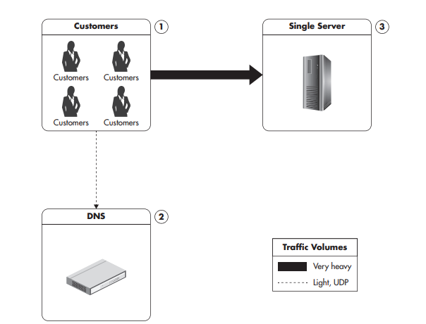
Single Server Setup
Web pages, images, Cascading Style Sheet (CSS) files, and videos have to be generated or served by the server
All of the traffic and processing will have to be handled by the single machine
a blog, a forum, or a self-service web application.

Slide 7
Reasons why this configuration is not going to take you far scalability-wise
user base grows, that results in increasing traffic
database grows. As this happens, your database queries begin to slow down due to the extra CPU, memory, and I/O requirements.
Adding new functionality to the system. That makes user interactions require more system resources.
One can experience any combination of these factors.

Slide 8
Making Server Stronger
Vertical scalability is accomplished by upgrading the hardware and/or network throughput. It is often the simplest solution for short-term scalability as it does not require architectural changes to your application. It can be as simple as upgrading your (virtual) server instance to a more powerful one. However, vertical scaling comes with some serious limitations, main one being cost as it becomes extremely expensive beyond a certain point.
Adding more I/O capacity by adding more hard drives in Redundant Array of Independent Disks (RAID) arrays.
Improving I/O access times by switching to solid-state drives (SSDs).
Improving I/O access times by switching to solid-state drives (SSDs).
Improving network throughput by upgrading network interfaces or installing additional ones.
Switching to servers with more processors or more virtual cores.

Slide 9
Issues with vertical scalability
Cost
It has hard limits. Simply put, at a certain point, no hardware is available that could support further growth.
Finally, operating system design or the application itself may prevent you from scaling vertically beyond a certain point.
You will not be able to keep adding CPUs to keep scaling MySQL infinitely, due to increasing lock contention (especially if you use an older MySQL storage engine called MyISAM).

Slide 10
Lock and Lock Contention
Locks are used to synchronize access between execution threads to shared resources like memory or files. Lock contention is a performance bottleneck caused by inefficient lock management.
Vertical Scalability does not affect system architecture in any way. There is no need to modify code or re architect anything. Just replace a piece of hardware with stronger or faster piece of hardware.

Slide 11
Isolation of Services
Another simple solution is moving different parts of the system to separate physical servers by installing each type of service on a separate physical machine.
Isolation of services is a great next step for single-server setup, as you can distribute the load among more machines than before and scale each of them vertically as needed.
you can deploy services like File Transfer Protocol (FTP), DNS, cache, database and others each on a dedicated physical machine.

Slide 12
Functional Partitioning
The core concept behind isolation of services is that you should try to split your monolithic web application into a set of distinct functional parts and host them independently. The process of dividing a system based on functionality to scale it independently is called functional partitioning.

Slide 13
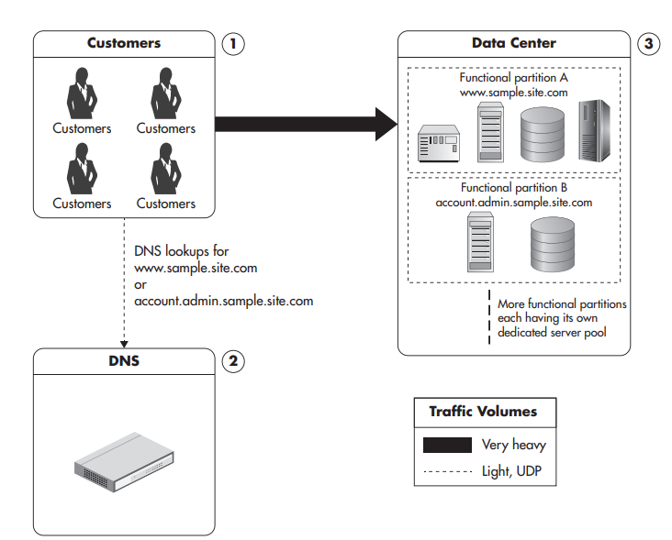

Slide 14
Cache
Cache is a server/service focused on reducing latency and resources needed to generate the result by serving previously generated content.
It will be discussed in detail in coming classes.

Slide 15
Content Delivery Network
A content delivery network (CDN) is a hosted service that takes care of global distribution of static files like images, JavaScript, CSS and videos. It works as an HTTP proxy. Using CDN is not only cost effective, but often much transparent.
Clients that need to download images, JavaScript, CSS, or videos connect to one of the servers owned by the CDN provider instead of your servers.
If the CDN server does not have the requested content yet, it asks your server for it and caches it from then on. Once the file is cached by the CDN, subsequent clients are served without contacting your servers at all.

Slide 16
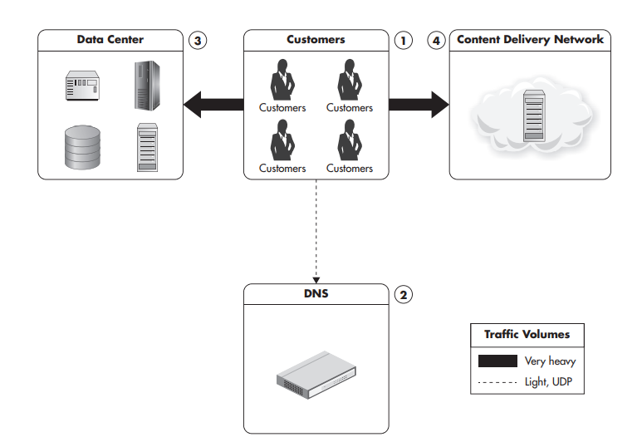

Slide 17
Horizontal Scalability
Horizontal scalability is accomplished by a number of methods to increase capacity by adding more servers. Horizontal scalability is considered the holy grail of scalability as it overcomes the increasing cost of capacity unit associated with scaling by buying ever-stronger hardware.
Systems should start by scaling horizontally in areas where it is the easiest to achieve, like web servers and caches, and then tackle the more difficult areas, like databases or other persistence stores.

Slide 18
Round-robin DNS
It is a DNS server feature to resolve a single domain name to one of the many IP addresses. Round-robin DNS maps the domain name to multiple IP addresses, each IP point to a different machine.
Then each time a client asks for a name resolution, DNS responds with one of the IP addresses.
Goal is to direct traffic from one client to one of the web servers — different clients may be connected to different servers without realizing it. Once a client receives an IP address, it will only communicate with the selected server.

Slide 19
Problem with Round-robin DNS
You cannot remove a server out of rotation because clients might have its IP address cached.
You cannot add a server to increase capacity either, because clients who have already had resolved the domain name will keep connecting to the same server.
Instead, put a load balancer between web servers and clients.

Slide 20
GeoDNS
GeoDNS is a DNS service that allows domain names to be resolved to IP addresses based on the location of the customer.
The goal is to direct customer to the closest data center to minimize network latency.

Slide 21
Edge cache
Another way to reduce latency.
Edge cache is a HTTP cache server located near the customer, allowing the customer to partially cache HTTP traffic.
It is most efficient when acting as simple reverse proxy servers caching entire pages. It can also decide that the page is un-cacheable and delegate fully to your web servers.

Slide 22
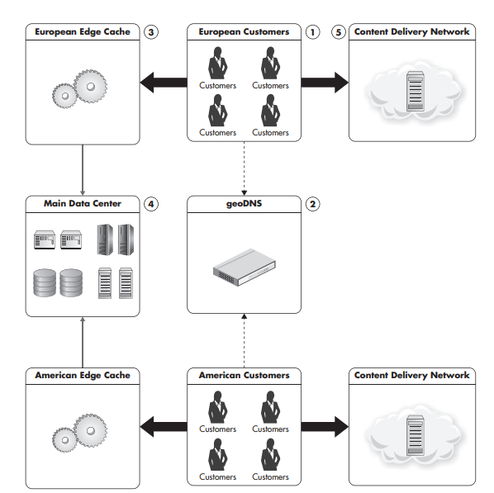
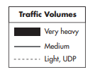

Slide 23
Overview of a Data Center Infrastructure
There are many components that serve a specialized function and can be added or removed independently.
We’ll take a deeper dive into these topics throughout the course, but first let’s lay out the overall communication flow and functions of each technology type

Slide 24
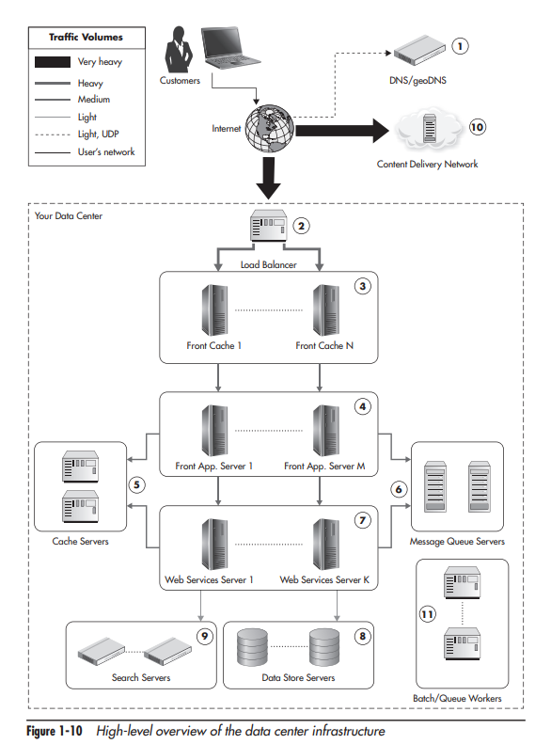

Slide 25
The Front Line
It is a set of components that users’ devices interact with directly.
Parts of the front line may reside inside of our data center or outside of it, depending on the details of the configuration and third-party services used.
These components do not have any business logic, and their main purpose is to increase the capacity and allow scalability.

Slide 26
Load Balancer
A load Balancer is a software or hardware component that distributes traffic coming to a single IP address over multiple servers, which are hidden behind the load balancer. It is used to share the load evenly among multiple servers and allow dynamic addition or removal of those servers.
It is common to use third-party services as load balancers, CDN, and reverse proxy servers; in such cases this layer may be hosted entirely by third-party providers.

Slide 27
Web Application Layer
It consists of web application servers responsible for generating the actual HTML of our web application and handling clients’ HTTP requests.
The main responsibility of these servers is to render the user interface.
Web application servers are usually easy to scale since they should be completely stateless.

Slide 28
Web Services Layer
It contains most of our application logic.
By creating web services, we also make it easier to create functional partitions. We can create web services specializing in certain functionality and scale them independently.
For example, in an e-commerce web application, you could have a product catalog service and a user profile service, each providing very different types of functionality and each having very different scalability needs

Slide 29
The communication protocol used between front-end applications and web services is usually Representational State Transfer (REST) or Simple Object Access Protocol (SOAP) over HTTP.
let’s think of web services as the core of our application and a way to isolate functionality into separate subsystems to allow independent development and scalability.

Slide 30
Object Cache
Object cache servers are used by both front-end application servers and web services to reduce the load put on the data stores and speed up responses by storing partially precomputed results.

Slide 31
Message Queues
Message queues are used to postpone some of the processing to a later stage and to delegate work to queue worker machines
These machines are not involved in generating responses to users’ requests; they are offline job-processing servers providing features like asynchronous notifications, order fulfillment, and other high-latency functions.

Slide 32
Data Persistence Layer
This is usually the most difficult layer to scale horizontally
This is an area of rapid development of new technologies labeled as big data and NoSQL, as increasing amounts of data need to be stored and processed, regardless of their source and form.

Slide 33
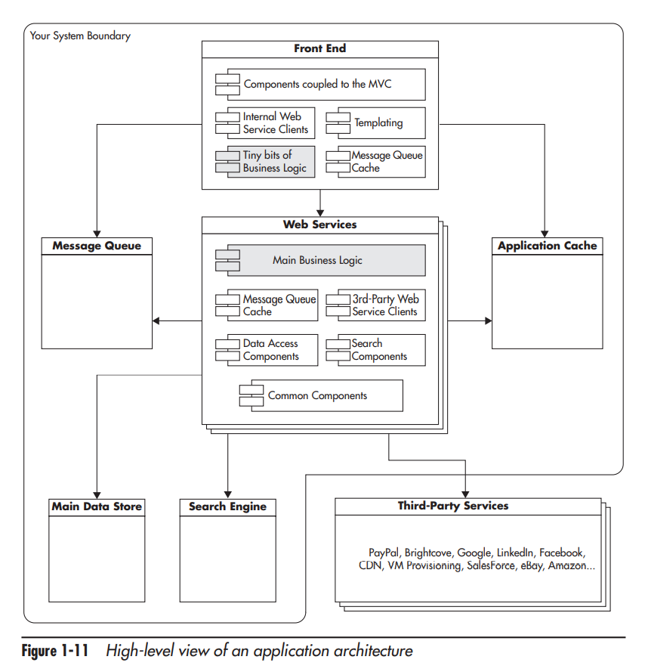

Slide 34
Front End
One can think of a front-end application as a plugin that can be removed, rewritten in a different programming language, and plugged back in.
One should also be able to remove the “HTTP”- based front-end and plug in a “mobile application” front end or a “command line” front end.
We can cache an entire HTML page or an HTML fragment, we save much more processing time than caching just the database query that was used to render this HTML.

Slide 35
Application Architecture Types
Service-oriented architecture (SOA) is architecture centered on loosely coupled and highly autonomous services focused on solving business needs. Note: this term is probably the grandfather of micro-services.

Slide 36
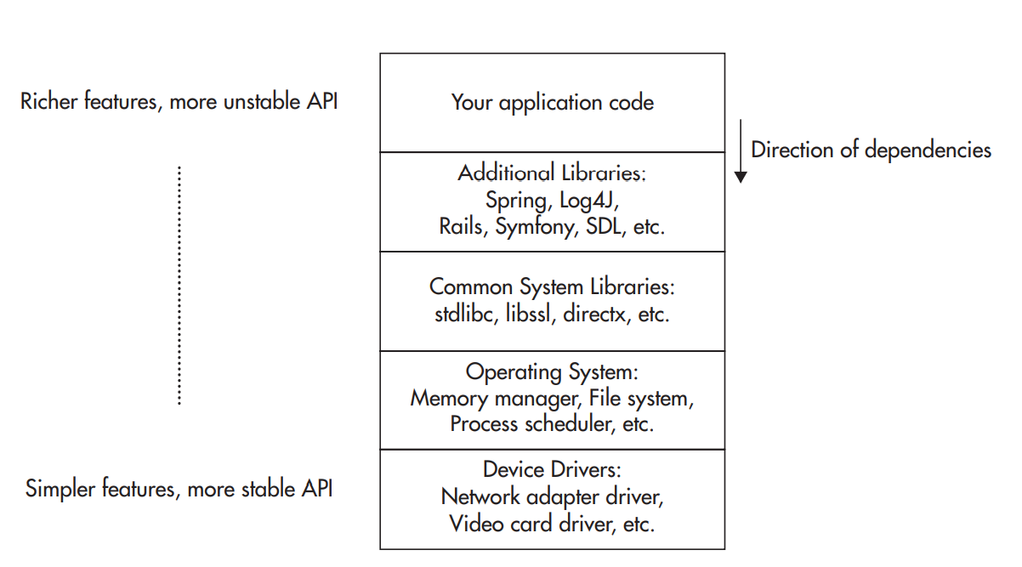
Multilayer Architecture
A multilayer architecture is a way to divide functionality into a set of layers. Components in the lower layers expose an application programming interface (API) that can be consumed by clients residing in the layers above, but you can never allow lower layers to depend on the functionality provided by the upper layers.

Slide 37
Hexagonal Architecture
Hexagonal architecture assumes that the business logic is in the center of the architecture and all the interactions with the data stores, clients, and other systems are equal.
There is a contract between the business logic and every non business logic component, but there is no distinction between the layers above and below.
Users interacting with the application are no different from the database system that the application interacts with. They both reside outside of the application business logic and both deserve a strict contract.

Slide 38
Event-driven architecture (EDA)
Event-driven architecture, as the name implies, is about reacting to events that have already happened
In a traditional programming model, we typically expect this operation to be performed while we are waiting for a result, and once we get the result, we continue our processing.
In EDA, we don’t wait for things to be done. Whenever we have to interact with other components, we announce things that have already happened and proceed with our own processing.

Slide 39
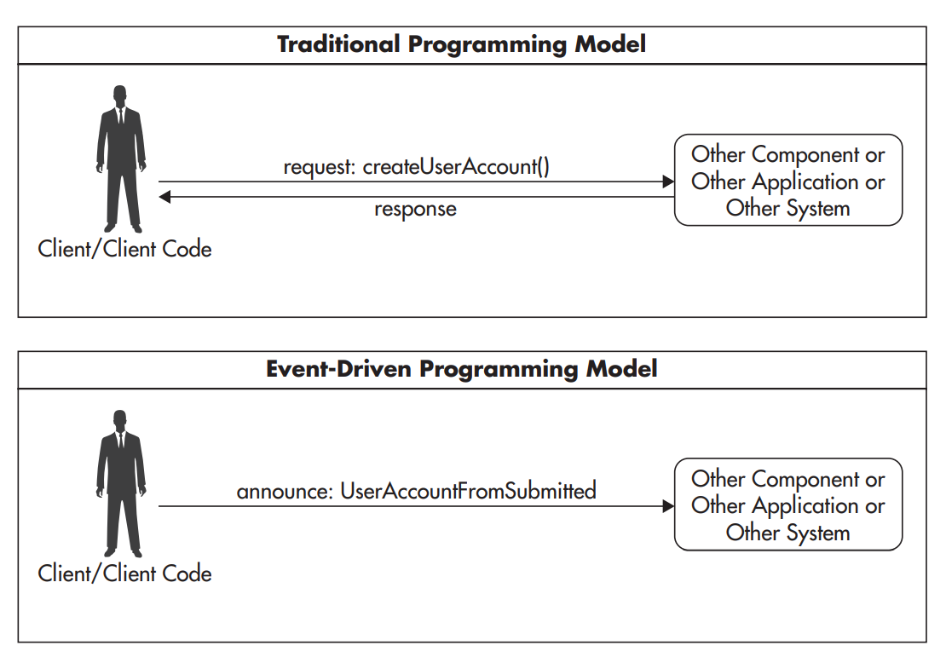

Slide 40
end

